Slide 1
Similarity
Geometry
Chapter 6
Notes:
Geometry 6

Slide 2
This Slideshow was developed to accompany the textbook
  Larson Geometry
  By Larson, R., Boswell, L., Kanold, T. D., & Stiff, L.
  2011 Holt McDougal
Some examples and diagrams are taken from the textbook.
Slides created by
Richard Wright, Andrews Academy
rwright@andrews.edu

Slide 3
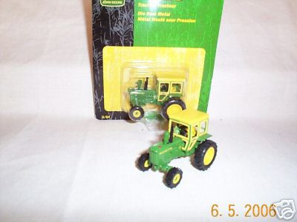
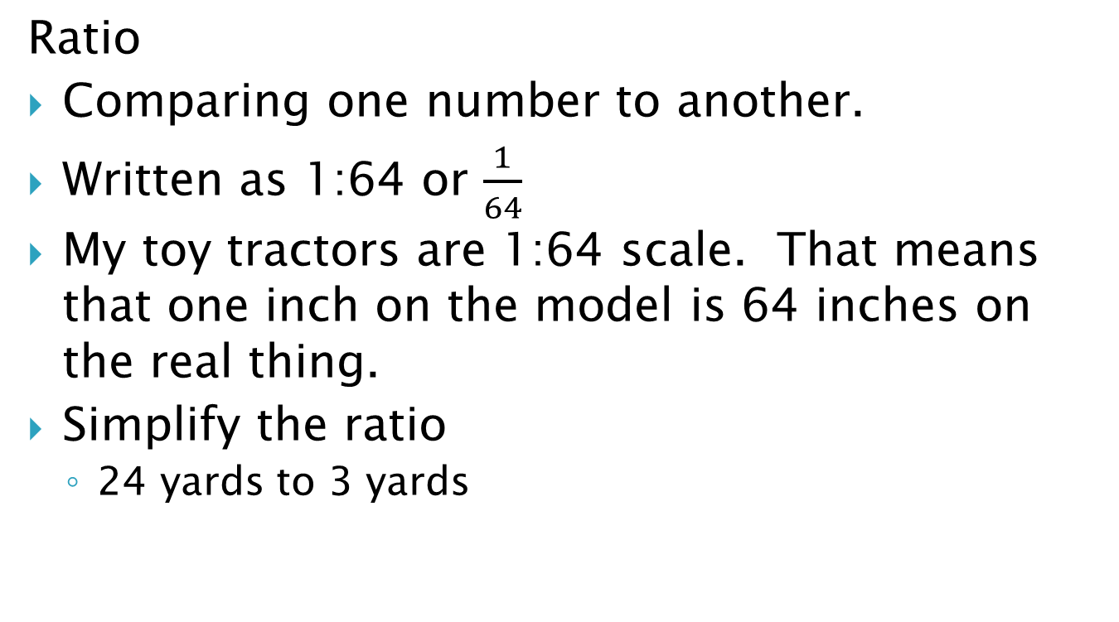
6.1 Ratios, Proportions, and the Geometric Mean
Ratio
Comparing one number to another.
Written as 1:64 or $\frac{1}{64}$
My toy tractors are 1:64 scale. That means that one inch on the model is 64 inches on the real thing.
Simplify the ratio
  24 yards to 3 yards
Notes:
$$\frac{24}{3}=\frac{8}{1}$$

Slide 4
6.1 Ratios, Proportions, and the Geometric Mean
A triangle’s angle measures are in the extended ratio of 1 : 3 : 5. Find the measures of the angles
Notes:
1x + 3x + 5x = 180
9x = 180
x = 20
Angles are 20, 60, 100

Slide 5
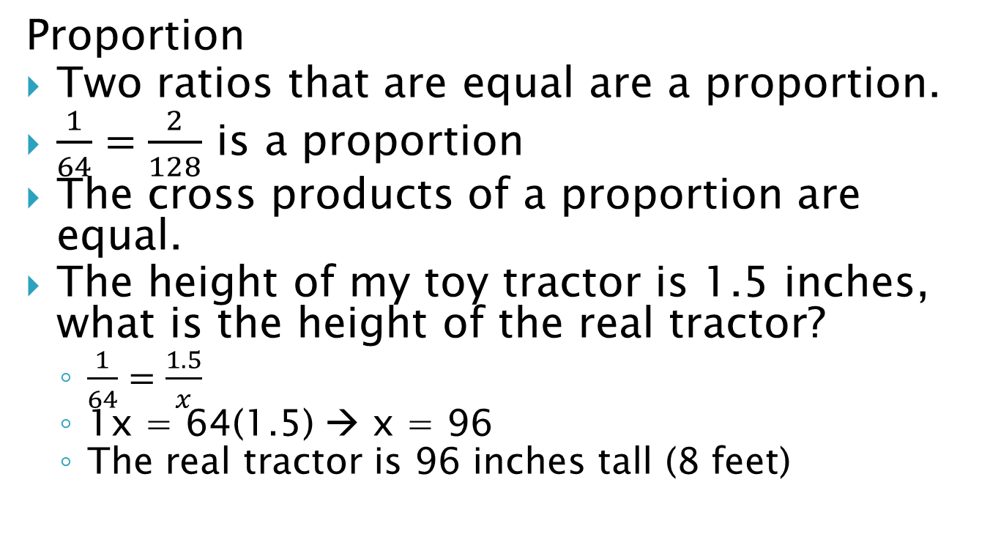
6.1 Ratios, Proportions, and the Geometric Mean
Proportion
Two ratios that are equal are a proportion.
$\frac{1}{64}=\frac{2}{128}$ is a proportion
The cross products of a proportion are equal.
The height of my toy tractor is 1.5 inches, what is the height of the real tractor?
  $\frac{1}{64}=\frac{1.5}{x}$
  1x = 64(1.5) → x = 96
  The real tractor is 96 inches tall (8 feet)

Slide 6
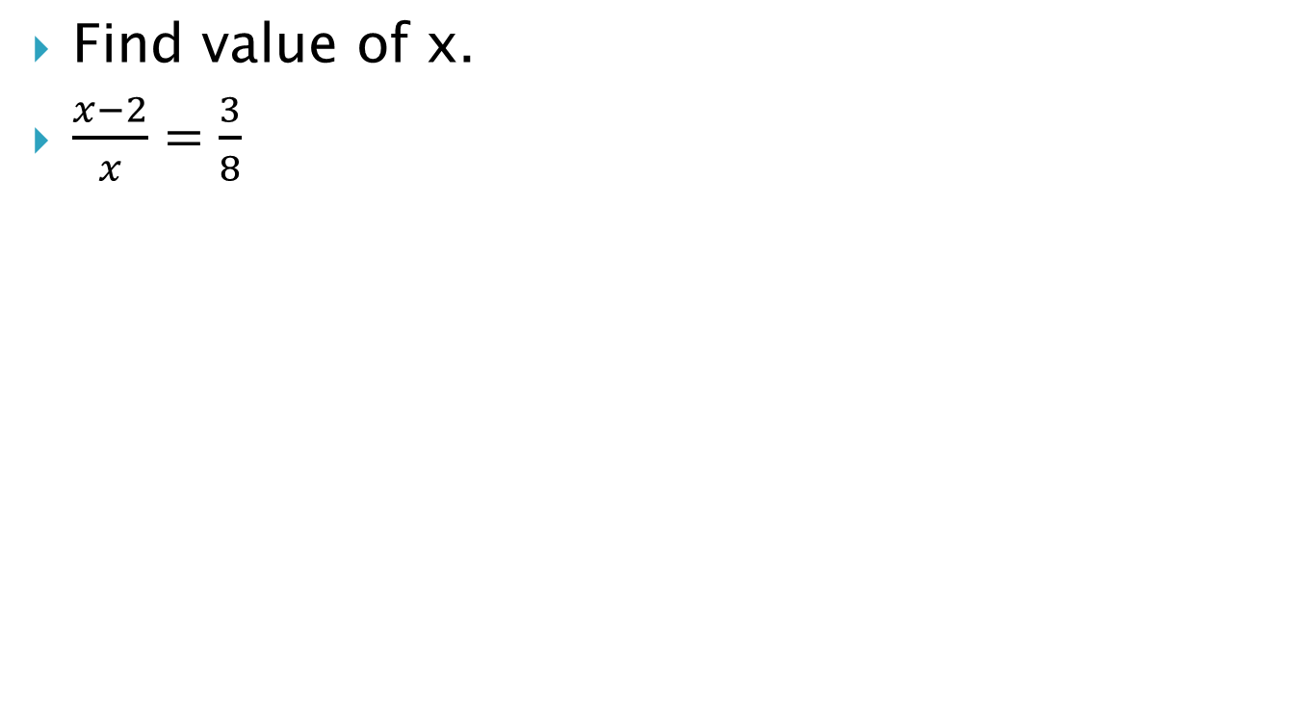
6.1 Ratios, Proportions, and the Geometric Mean
Find value of x.
$\frac{x−2}{x}=\frac{3}{8}$
Notes:
$$\frac{x−2}{x}=\frac{3}{8}$$
$$8\left(x−2\right)=3x$$
$$8x−16=3x$$
$$5x=16$$
$$x=\frac{16}{5}$$

Slide 7
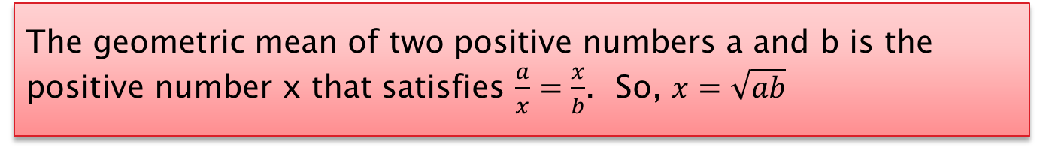
6.1 Ratios, Proportions, and the Geometric Mean
Geometric Mean
The geometric mean of two positive numbers a and b is the positive number x that satisfies $\frac{a}{x}=\frac{x}{b}$. So, $x=\sqrt{ab}$
Find the geometric mean of 18 and 54.
360 #4-44 even, 50, 52, 60, 72-80 even = 29
Notes:
$$x=\sqrt{18⋅54}$$
$$x=\sqrt{972}$$
$$x=31.18$$

Slide 8
Answers and Quiz
6.1 Answers
6.1 Quiz

Slide 9
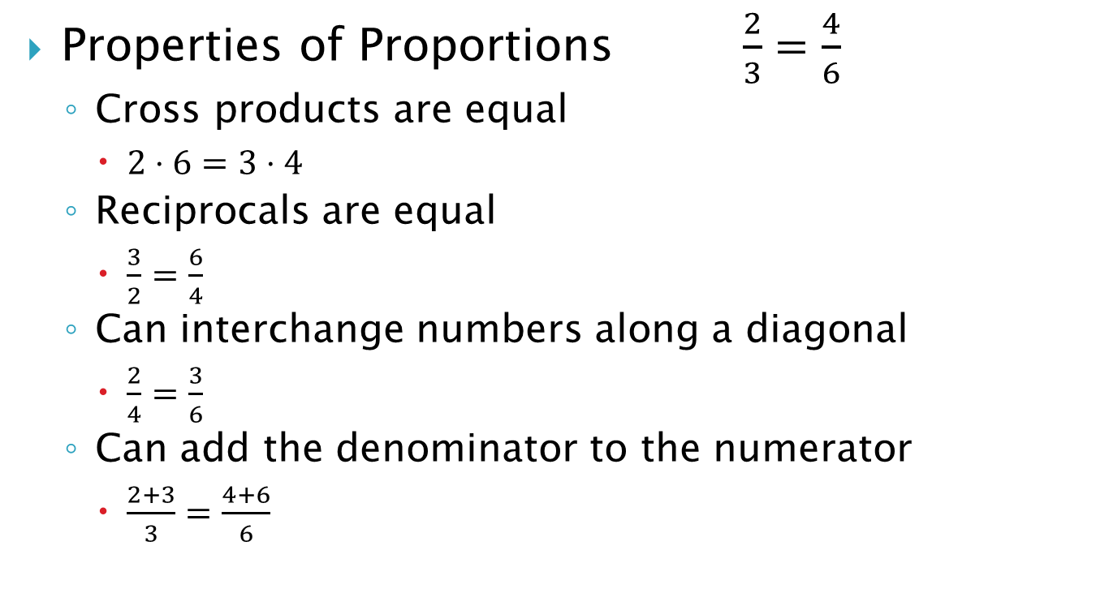
6.2 Use Proportions to Solve Geometry Problems
Properties of Proportions $\frac{2}{3}=\frac{4}{6}$
  Cross products are equal
    $2⋅6=3⋅4$
  Reciprocals are equal
    $\frac{3}{2}=\frac{6}{4}$
  Can interchange numbers along a diagonal
    $\frac{2}{4}=\frac{3}{6}$
  Can add the denominator to the numerator
    $\frac{2+3}{3}=\frac{4+6}{6}$

Slide 10
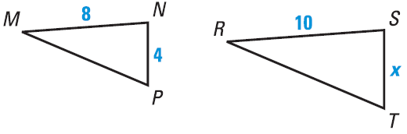
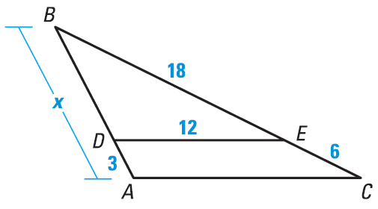
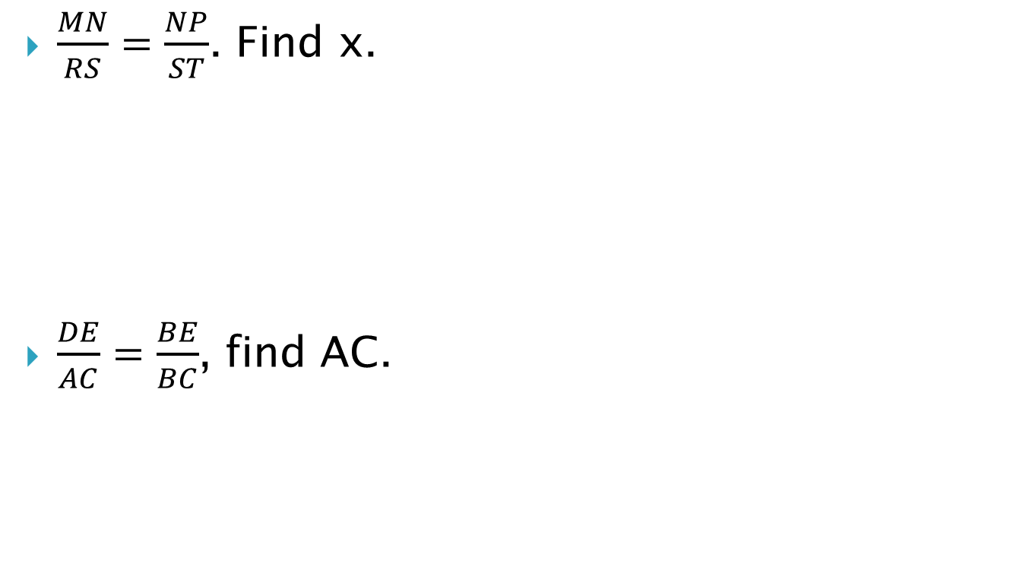
6.2 Use Proportions to Solve Geometry Problems
$\frac{MN}{RS}=\frac{NP}{ST}$. Find x.
$\frac{DE}{AC}=\frac{BE}{BC}$, find AC.
Notes:
$$\frac{MN}{RS}=\frac{NP}{ST}$$
$$\frac{8}{10}=\frac{4}{x}$$
$$8x=4⋅10$$
$$8x=40$$
$$x=5$$
$$\frac{DE}{AC}=\frac{BE}{BC}$$
$$\frac{12}{AC}=\frac{18}{18+6}$$
$$12⋅24=18⋅AC$$
$$288=18⋅AC$$
$$16=AC$$

Slide 11
6.2 Use Proportions to Solve Geometry Problems
Two cities are 96 miles from each other. The cities are 4 inches apart on a map. Find the scale of the map.
367 #2-18 even, 22-28 even, 38, 39 = 15
Extra Credit 370 #2, 6 = +2
Notes:
$$\frac{4 inches}{96 miles}=\frac{1 inch}{24 miles}$$

Slide 12
Answers and Quiz
6.2 Answers
6.2 Quiz

Slide 13
6.3 Use Similar Polygons
When I put something on the overhead projector, the projected image is larger than what is on the screen. The image is of a different size, but the same shape as what I write. They are similar.
Notes:
Have the overhead ready

Slide 14
6.3 Use Similar Polygons
Similar figures
When two figures are the same shape but different sizes, they are similar.
Similar polygons (~)
Polygons are similar iff corresponding angles are congruent and corresponding sides are proportional.
Notes:
Draw polygon on projector. Have student measure angles on the projector and the screen. Have another student measure the sides on the projector and on the screen.
Check to see if corresponding angles are congruent.
Check to see if corresponding sides are proportional.

Slide 15
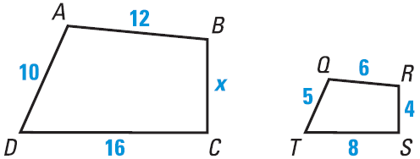
6.3 Use Similar Polygons
Ratio of lengths of corresponding sides is the scale factor.
ABCD ~ QRST
What is the scale factor of QRST to ABCD?
Find x.
Notes:
Scale factor: $\frac{6}{12}=\frac{1}{2}$
x: $\frac{1}{2}=\frac{4}{x}$ → x = 8

Slide 16
6.3 Use Similar Polygons
Perimeters of Similar Polygons
If two polygons are similar, then the ratio of their perimeters is equal to the ratios of their corresponding side lengths.
Congruent polygons have a scale factor of 1:1

Slide 17
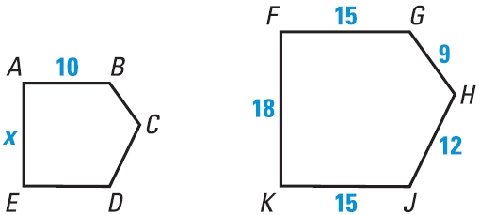
6.3 Use Similar Polygons
ABCDE ~ FGHJK
Find the scale factor of FGHJK to ABCDE
Find x
Find the perimeter of ABCDE
Notes:
Scale factor: $\frac{15}{10}=\frac{3}{2}$
x: $\frac{3}{2}=\frac{18}{x}$ → $3x=36$ → $x=12$
Perimeter: $\frac{3}{2}=\frac{15+9+12+15+18}{P}$ → $\frac{3}{2}=\frac{69}{P}$ → $3P=138$ → P = 46

Slide 18
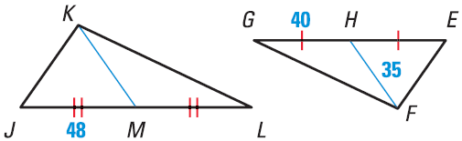
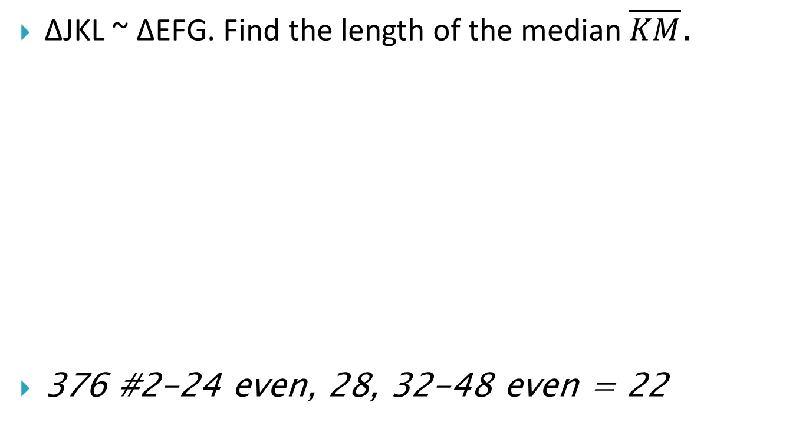
6.3 Use Similar Polygons
ΔJKL ~ ΔEFG. Find the length of the median $\overline{KM}$.
376 #2-24 even, 28, 32-48 even = 22
Notes:
$$\frac{48}{40}=\frac{KM}{35}$$
$$40⋅KM=48⋅35$$
$$40⋅KM=1680$$
$$KM=42$$

Slide 19
Answers and Quiz
6.3 Answers
6.3 Quiz

Slide 20
6.4 Prove Triangles Similar by AA
Draw two triangles with two pairs of congruent angles. Measure the corresponding sides. Are they proportional? Are the triangles similar?
55°
34°
55°
34°
AA Similarity
If two angles of one triangle are congruent to two angles of another triangle, then the triangles are similar.

Slide 21
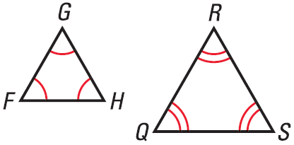
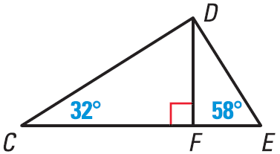
6.4 Prove Triangles Similar by AA
Show that the triangles are similar. Write a similarity statement.
Notes:
ΔFGH ~ ΔQRS by AA Similarity
m∠CDF = 58 by Triangle Sum Theorem
ΔCDF ~ ΔDEF by AA Similarity

Slide 22
6.4 Prove Triangles Similar by AA
You can use similar triangles to find things like the height of a tree by using shadows. You put a stick perpendicular to the ground. Measure the stick and the shadow. Then measure the shadow of the tree. The triangles formed by the stick and the shadow and the tree and its shadow are similar so the height of the tree can be found by ratios. Suppose we use a meter stick. The stick’s shadow is 3 m. The tree’s shadow is 150 m. How high is the tree?
384 #4-22 even, 26-32 even, 41-46 all, 48 = 21
Notes:
$$\frac{\text{Tree} \text{Shadow}}{\text{Stick} \text{Shadow}}=\frac{\text{Tree} \text{Height}}{\text{Stick} \text{Height}}$$
$$\frac{150}{3}=\frac{x}{1}$$
$$x=50 m$$

Slide 23
Answers and Quiz
6.4 Answers
6.4 Quiz

Slide 24
6.5 Prove Triangles Similar by SSS and SAS
SSS Similarity
If the measures of the corresponding sides of two triangles are proportional, then the triangles are similar.
SAS Similarity
If the measures of two sides of a triangle are proportional to the measures of two corresponding sides of another triangle and the included angles are congruent, then the triangles are similar.
Notes:
SSS Similarity - That’s what happens when you enlarge a drawing.

Slide 25
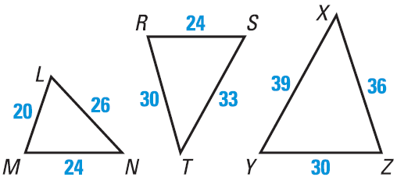
6.5 Prove Triangles Similar by SSS and SAS
Which of the three triangles are similar?
The shortest side of a triangle similar to ΔRST is 12 units long. Find the other side lengths of the triangle.
Notes:
Try ΔLMN and ΔRST: $\frac{20}{24}=\frac{24}{30}=\frac{26}{33}$ This is not true.
Try ΔLMN and ΔXYZ: $\frac{20}{30}=\frac{24}{36}=\frac{26}{39}$ This is true. ΔLMN ~ ΔYZX
Try ΔXYZ and ΔRST: $\frac{30}{24}=\frac{36}{30}=\frac{39}{33}$ This is not true.
$$\frac{12}{24}=\frac{x}{30}=\frac{y}{33}$$
$\frac{12}{24}=\frac{x}{30}$ → 24x = 360 → x = 15
$\frac{12}{24}=\frac{y}{33}$ → 24y = 396 → x = 16.5

Slide 26
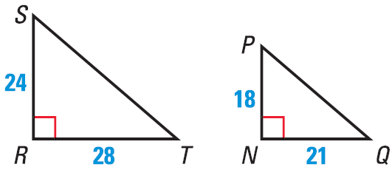
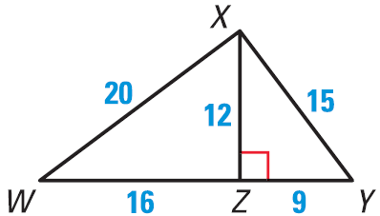
6.5 Prove Triangles Similar by SSS and SAS
Explain how to show that the indicated triangles are similar.
ΔSRT ~ ΔPNQ
ΔXZW ~ ΔYZX

Slide 27
6.5 Prove Triangles Similar by SSS and SAS
391 #4-24 even, 25, 26, 30, 32, 36, 38, 41-44 all = 21
Extra Credit 395 #2, 6 = +2

Slide 28
Answers and Quiz
6.5 Answers
6.5 Quiz

Slide 29
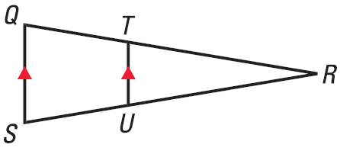
6.6 Use Proportionality Theorems
Triangle Proportionality Theorem
If a line is parallel to a side of a triangle, then it separates the other two sides into proportional segments.
And the converse is also true. Proportional segments → line parallel to the third side.

Slide 30
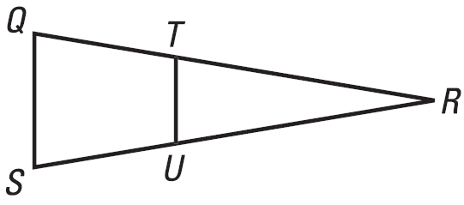
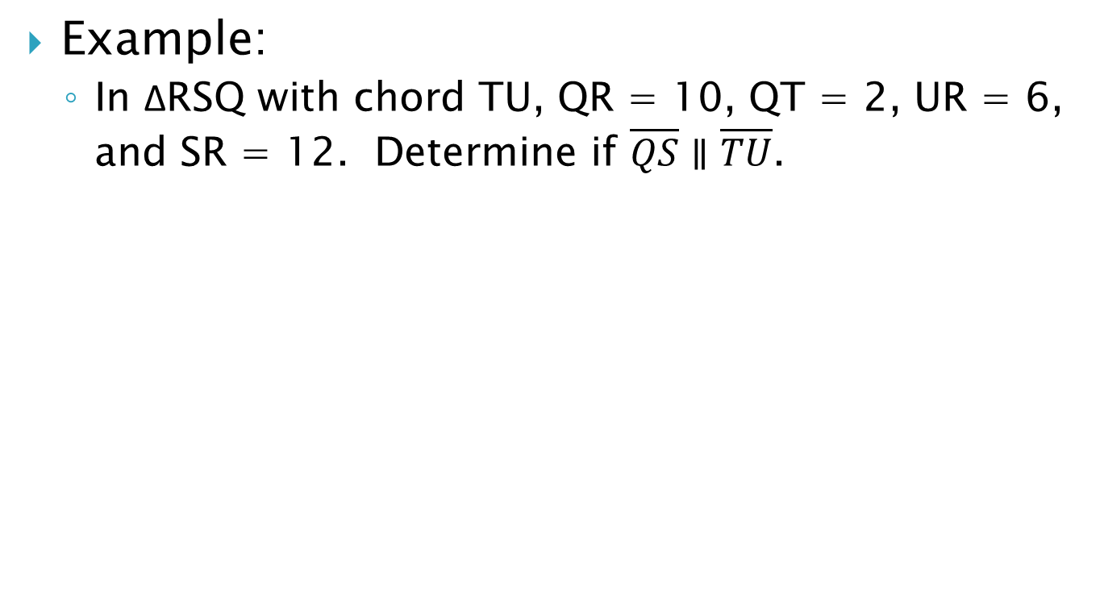
6.6 Use Proportionality Theorems
Example:
  In ΔRSQ with chord TU, QR = 10, QT = 2, UR = 6, and SR = 12. Determine if $\overline{QS}∥\overline{TU}$.
Notes:
ANS: TR = 10 – 2 = 8, US = 12 – 6 = 6
TR/QT = RU/US → 8/2 = 6/6 → 4 = 1 False, not parallel

Slide 31
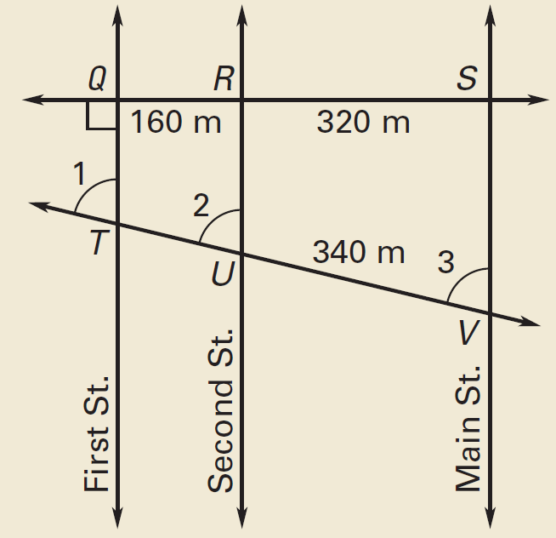
6.6 Use Proportionality Theorems
If three or more parallel lines intersect two transversals, then they cut off the transversals proportionally.
Example:
  Using the information in the diagram, find the distance TV.
Notes:
$$\frac{TU}{340}=\frac{160}{320}$$
$$320TU=54400$$
$$TU=170$$
$$TV=TU+UV=170+340=510 m$$

Slide 32
6.6 Use Proportionality Theorems
An angle bisector in a triangle separates the opposite side into segments that have the same ratio as the other two sides.
12
Find x
400 #2-18 even, 22, 24, 28, 30-36 even = 16
10
x
18
Notes:
10 / x = 12 / (18 – x) → 10 (18 – x) = 12x → 180 – 10x = 12x → 180 = 22x → x = 180/22 = 8.18

Slide 33
Answers and Quiz
6.6 Answers
6.6 Quiz

Slide 34
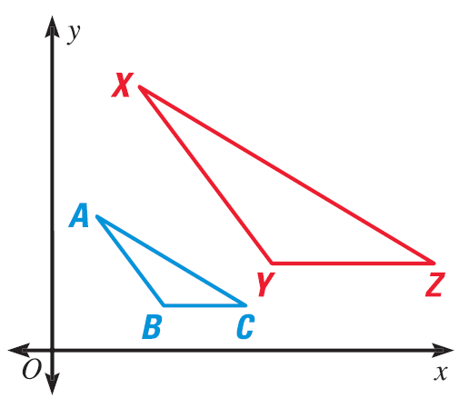
6.7 Perform Similarity Transformations
Dilation
  Transformation that stretches or shrinks a figure to create a similar figure.
The figure is enlarged or reduced with respect to a point called the center of dilation
The scale factor of a dilation is the ratio of a side of the image to the corresponding side of the original

Slide 35
6.7 Perform Similarity Transformations
Coordinate Notation for a Dilation with respect to the origin
  (x, y) → (kx, ky) where k is the scale factor
  If 0 < k < 1, reduction
  If k > 1, enlargement

Slide 36
6.7 Perform Similarity Transformations
Find the coordinates of L, M, and N so that ΔLMN is a dilation of ΔPQR with a scale factor of k. Write the coordinate notation for the dilation.
P(-2, -1), Q(-1, 0), R(0, -1); k = 4
Notes:
(x, y) → (4x, 4y)
L(-8, -4), M(-4, 0), N(0, -4)

Slide 37
6.7 Perform Similarity Transformations
Suppose a figure containing the origin is dilated. Explain why the corresponding point in the image of the figure is also the origin.
Origin is (0, 0). k(0) = 0. so (k0, k0) = (0,0)
412 #2-22 even, 30, 36, 38, 40-43 all = 18
Extra Credit 415 #2,4 = +2
Notes:
(x, y) → (kx, ky)
If x and y are 0, then kx and ky are 0.

Slide 38
Answers and Quiz
6.7 Answers
6.7 Quiz

Slide 39
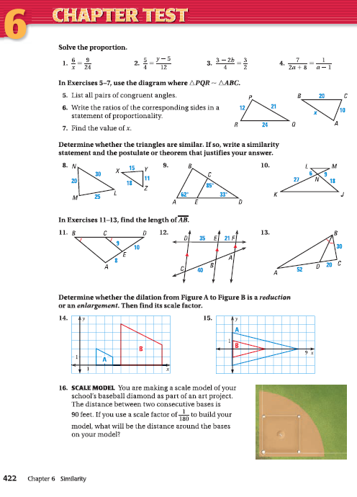
6.Review
422 #1-16 = 16

